Slide 1
Automation Testing of orangehrm Website Using Selenium Webdriver
Group Members:
Huzaifa Kashif - (22K-5158)
Omer Ayaz Khan – (22K-5173)
Syed Yousif Ali Shah – (22K-5174)

Slide 2
Selenium Webdriver
A powerful tool for automating web applications across various browsers.
Provides a programming interface to interact with web elements on a web page.
Types Of Testing Supported By Selenium:
Functional Testing: Regression, User Acceptance.
Non-Functional Testing: Performance, Load.
Compatibility Testing: Cross-Browser, Cross-Platform, Device.
Security Testing: Vulnerability, Penetration.
Usability Testing: User Experience.

Slide 3
Selenium Webdriver
Advantages:
Cross-Browser Compatibility:
Supports major browsers, like Chrome, Safari, Firefox, Edge, allowing test cases to be executed across different environments.
Supports Multiple Programming Languages:
Supports multiple programming languages (like Java, C#, Python, Ruby, JavaScript) for writing test scripts.
Real Browser Interaction:
Selenium Webdriver interacts directly with the browser.
Mimics real user interactions by performing actions at the OS level.

Slide 4
Selenium Webdriver
Disadvantages:
Limited to Web Applications:
Cannot be directly used for desktop or mobile applications without integrating with other tools (e.g., Appium for mobile).
No Built-In Reporting:
Relies on external frameworks like TestNG for comprehensive reporting.
Handling Dynamic Elements:
Dealing with dynamic web elements (eg; that load asynchronously) requires additional handlings, like wait.

Slide 5
application Selected For Automation Testing
OrangeHRM (Demo Version):
A web-based HR management system, commonly used for managing HR processes like user management, employee management, recruitment, attendance, and performance.

Slide 6
Selection Criteria for Selenium webdriver
Application Type:
OrangeHRM is a web-based HR management application, which makes it ideal to utilize Selenium Webdriver for functional testing.
Open-Source:
No licensing costs are required for using Selenium Webdriver.
Community Support:
Selenium Webdriver has a large community, providing ample tutorials, documents, and troubleshooting assistance.

Slide 7
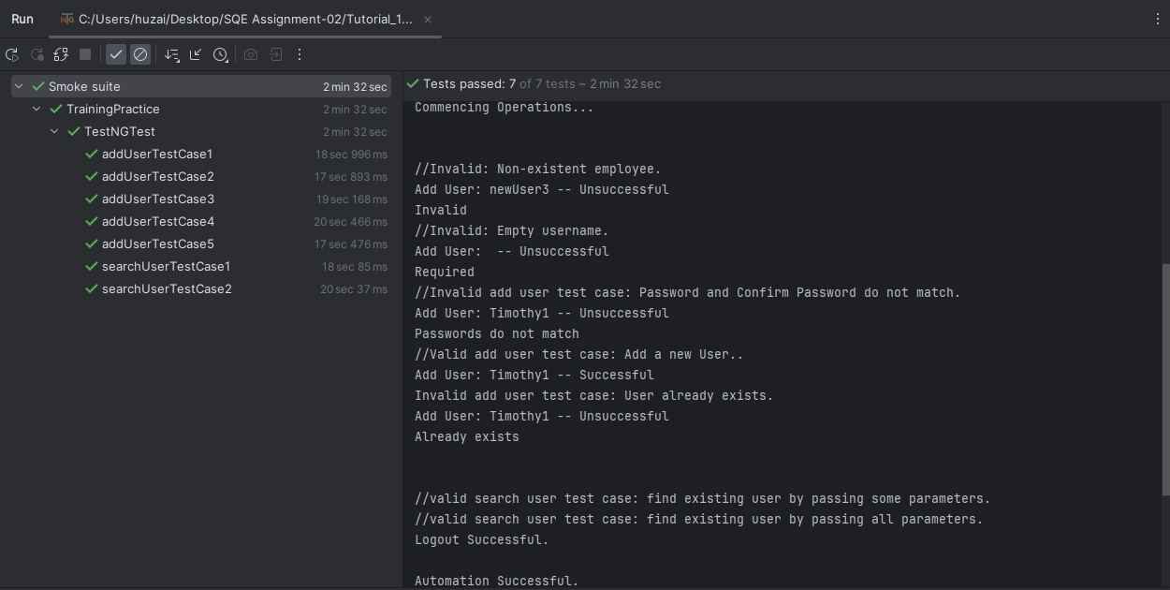
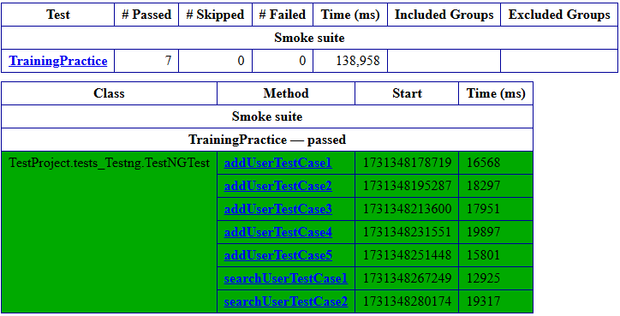
Test Case Output And Emailable-Report (Log)

Slide 8
The End

